Slide 1


Acoustic Air Filtration
A New Generation of
Energy Efficient
Air Filtration Technology
June 2019

Slide 2
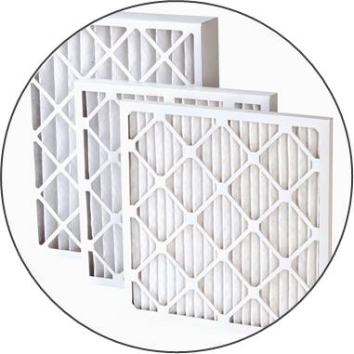
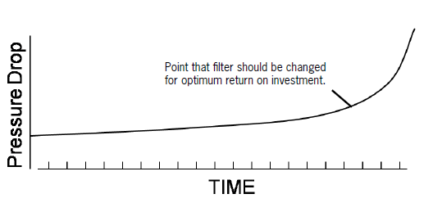
Industry Overview
80% of the lifecycle cost of an air filter is on energy
The global market for air filter is estimated to surpass US$19B by 2022 (TechSci Research report)
The global market for air purification equipment is expected to exceed US$14.5B by 2022. (Global Industry Analysts)
Worldwide spending on air filter: over US$10B/ year
Worldwide spending on air filtration energy cost: over US$40B/ year
High energy efficiency air filtration is highly desired
In a standard HVAC system, a filter may be responsible for up to 60% of the energy cost to move air through the system (Energy and Air Filter Fact Handbook)
165 million tonnes of carbon dioxide emission from air filtration energy cost

Slide 3
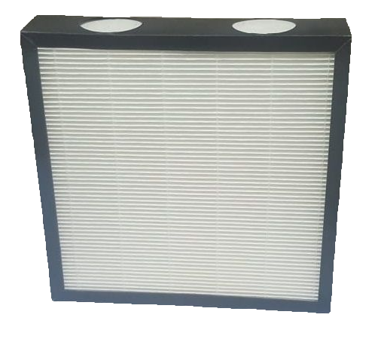
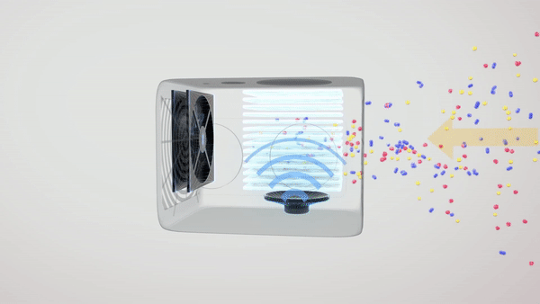
Acoustic Air Vibration
Technology Overview
Aurabeat’s technology utilizes acoustic energy
to induce rapid vibration of the particles in air
Patent
US Patent: US10159925B2
EU Patent: EP3192580 A1
CN Patent: CN106955540 A

Slide 4

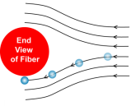
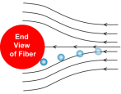


Acoustic Air Filtration
Cross-section of filter fiber
Air Streamline
Adding the Sixth Air Filtration Mechanism
The 6th mechanism – Acoustic Vibration
Significantly increase their traveling distance;
Generates additional turbulence; and
Increase the chance of particles entering the boundary layers of the filter fibers.
Sieving
Interception
Particle
Impaction
Electrostatic
Diffusion
Without acoustic vibration
With acoustic vibration
With acoustic vibration

Slide 5
Technical Specifications
Filtration Efficiency 95-99%;
EN1822: E10 - H11;
ASHRAE 52.2: MERV 11 -14

Slide 6
Unique Product Features
+50%
-60%
+50%
-40%
Improved
filtration performance
Lower in
pressure drop
Improved
energy efficiency up to 50%
Lower in
consumable cost
  Retrofittable to existing equipment, e.g. into air purifiers and air handling units
Highly customizable size
Collaboration or technology licensing opportunities with existing air filter manufacturers

Slide 7
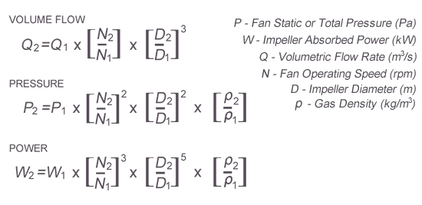
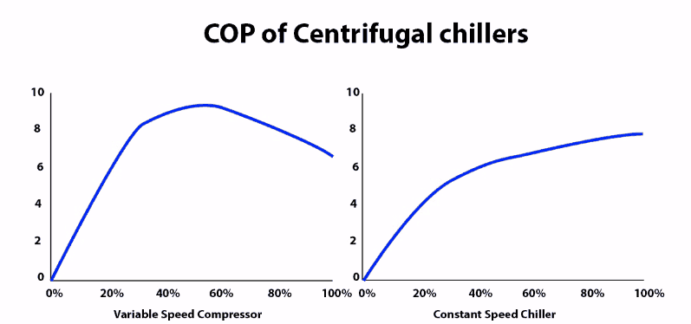
Energy Saving Potential
Air filter with an original filtration efficiency of 70% can be enhanced to 90%. This is literally upgrading a MERV 7, 8 rating filter to MERV rating 14 without increasing its pressure drop.
Typical pressure drop of :
MERV 8 air filter: ~60Pa
MERV 14 air filter: ~160Pa
For typical AHU system pressure drop: 1200Pa
P₁ = 1200Pa, P₂ = 1100; W₁/W₂ = 1.14
Power saving = 12.24%
For a typical small size AHU with 1.2m × 1.8m air flow area and 7.5kW air flow velocity operating in a commercial building 12 hours a day and 365 days a year, and a total acoustic power input of 36 W. The annual saving on electricity consumption is:
[(7.5 x 0.1224) – 0.036 ] × 12 × 365 = 3,863.16 kWh
Energy saving will be more substantial if the control are on chiller side, as part load COP of a chiller with variable speed control is higher than full load COP.

Slide 8
Lifecycle Cost Saving
Consumable cost saving:
~ 42% cost saving switching from Standard AHU size MERV 14 filter to Aurabeat filter (standard AHU size and efficiency equivalent to MERV 14)
Lifecycle cost saving:
~1200 tons of CO2 emission reduction

Slide 9
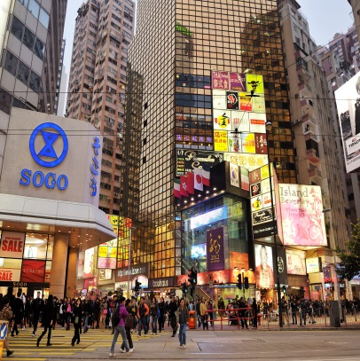
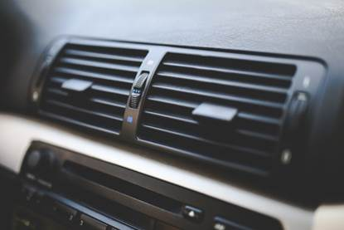
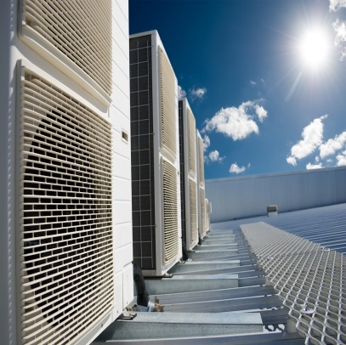
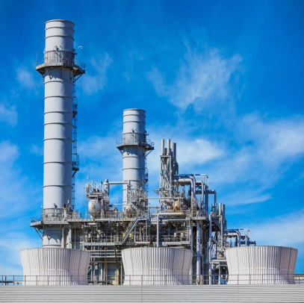
Applications
Buildings with centralized ventilation system
Air purifier & vehicles air filtration
Ventilation & air conditioning equipment
Industrial pollution control
e.g. office, mall, school, hotel, hospital, etc

Slide 10

Thank you for your time.
Dr. Roger Sze To
Tel: (852) 9736 9925
rogerszeto@aurabeat.com.hk

