Slide 1
WISX Smart Lift

Slide 2




Issues with Current Lift Maintenance Solution
Specialist engineer
OEMs Remote Monitoring & Diagnostic System
Lift Monitoring System
Shortage of skilled manpower
Lift downtime for inspection work
Costly
Multiple brands of lifts will require multiple systems
Information collected may not be sufficient for diagnostics.

Slide 3
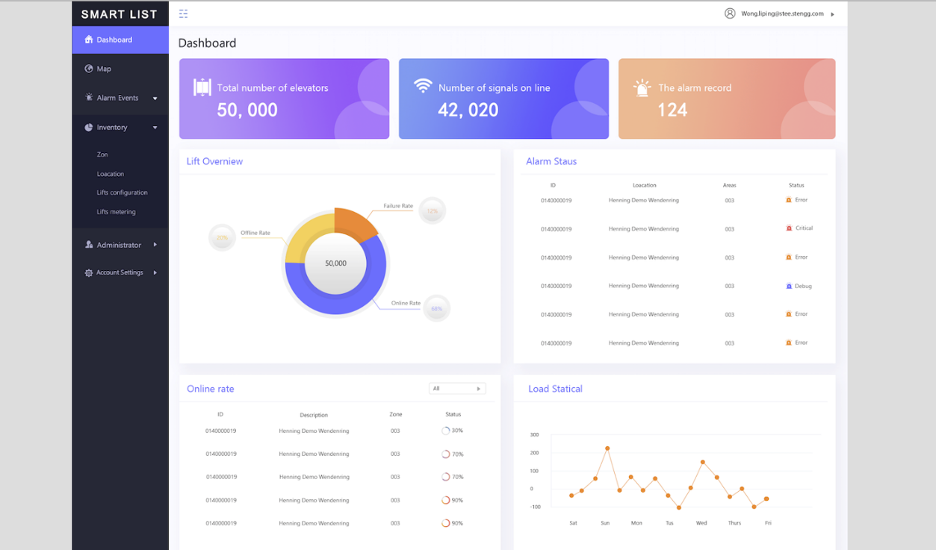
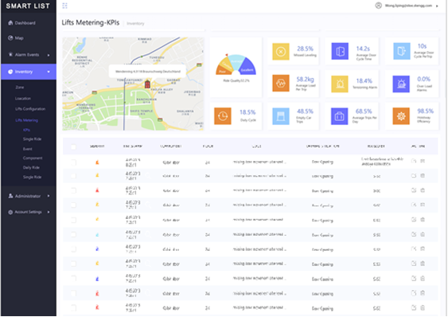
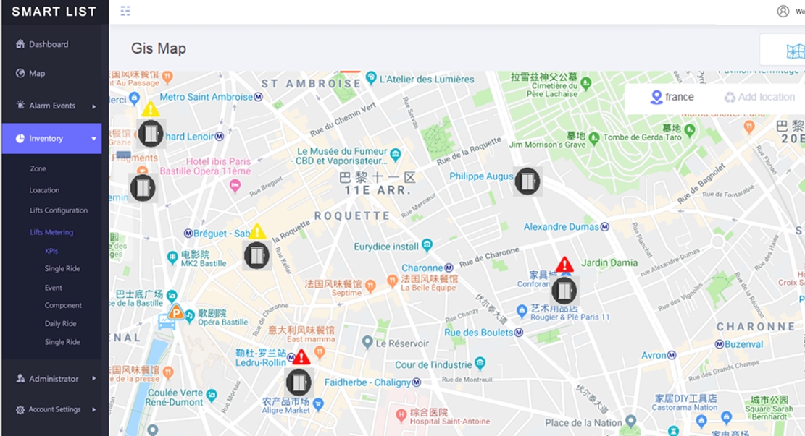
WISX Smart Lift Solution
Remote Monitoring & Diagnostics System to provide Town Councils, Lift companies and Servicemen with a one-stop solution for lift maintenance management, lift monitoring and fault management.
Proven Solution
  Ride Quality according to ISO 18738-1
  Non-intrusive monitoring suitable for all kinds of lift
  Years of research effort since 2004
  Edge Analytics Capability
Enhances Operational Efficiency
    Real-time status monitoring
    Automatic events identification and real time alerts
    Remote access to sensor performance
    Lift and lift maintenance KPIs
    Smart Map View
    Digital Lift Service Inspection Report
    Configurable Checklists for Maintenance Tasks
    Data history, reporting and analytics
Future-Proof and Scalable
    One open IoT platform, multiple smart city applications

Slide 4
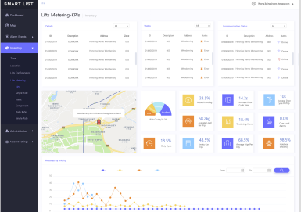
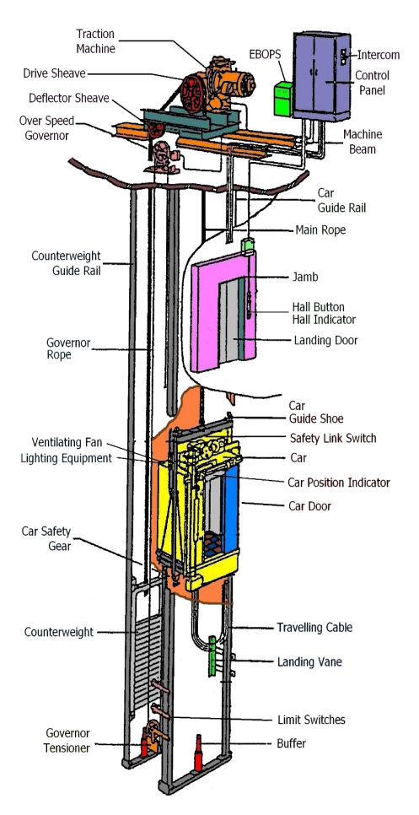
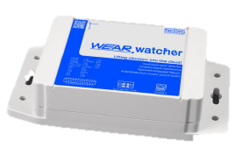

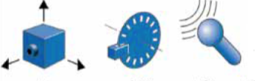
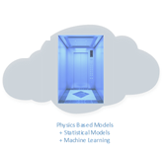


Solution Architecture
Sensor Parameters:
Load
Rope Tension
Rope Thickness
No of trips
Travelled mileage
Jerkiness
Door Utilization
Door Leveling
Door Anomalies
Vibration anomalies
Motion Anomalies
Speed anomalies (rated speed vs actual)
Vibration anomalies
Main Motor Current
Door Motor Current
Operator
Edge Processing Box
3G/4G
Smart Lift CMS
Sensors
Analytics
Integration
      Maintenance Report
Lift Maintenance Crew

Slide 5
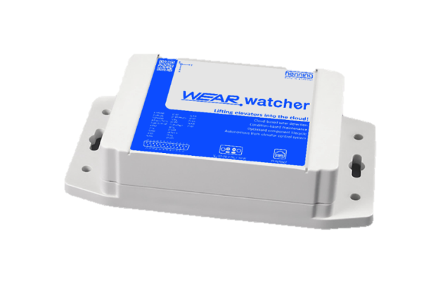
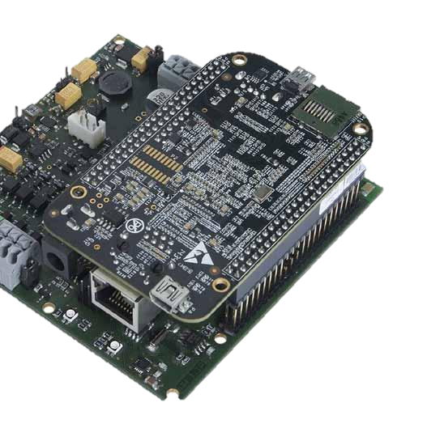

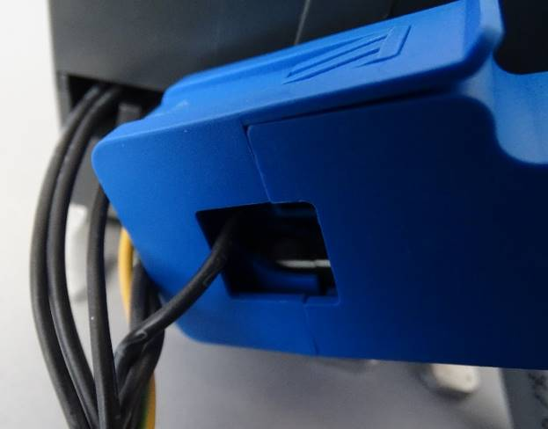

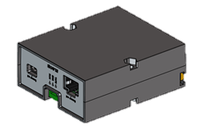
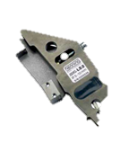
Lift Sensors Suite
Designed and manufactured for up to 10 years lifespan
Main Processing Unit (Car Top)
Edge Analytics Capability
>200 Key Evaluation Parameters (KEP)
Elevator Ride Sections
Load Classes
Data Reduction
Evaluation Strategy
Component Allocation
Findings Classification
Magnetic Door Switch
Current Sensor (Door Motor)
Absolute Positioning System
Pre-Evaluation Unit (Shaft Top)
Current Sensor (Lift Motor)
Rope Load Sensor
Acceleration and Vibration
MEMS based sensor built-in Main Processing Unit
Door Condition Measurement
Door movement
Levelling Measurement
Absolute position of lift car and car alignment.
Rope Condition
Tensioning status
Load Measurement
Empty lift car
Acceleration, Distance travelled/ Displacement, Speed, Vibration
Highly accurate, easy-to-install
Shaft efficiency
Traction force
Loading condition
Worn out rollers
Defects at door operator
Non-light/dust sensitive
Notes:
Rationale
Vibration Analysis key approach
Degradation of parts initiate vibration, slightest beyond human feel.
Vibration is pre-requite to produce sound, hence no requirement to monitor noise/sound
Load measurement is essential
Load value affect vibration signature
Load varies between static and dynamic load. Hence continuous load monitoring is essential for reliable and accurate predictive capability
Frequency Analysis
Key in root cause analysis, pin point problem area

Slide 6
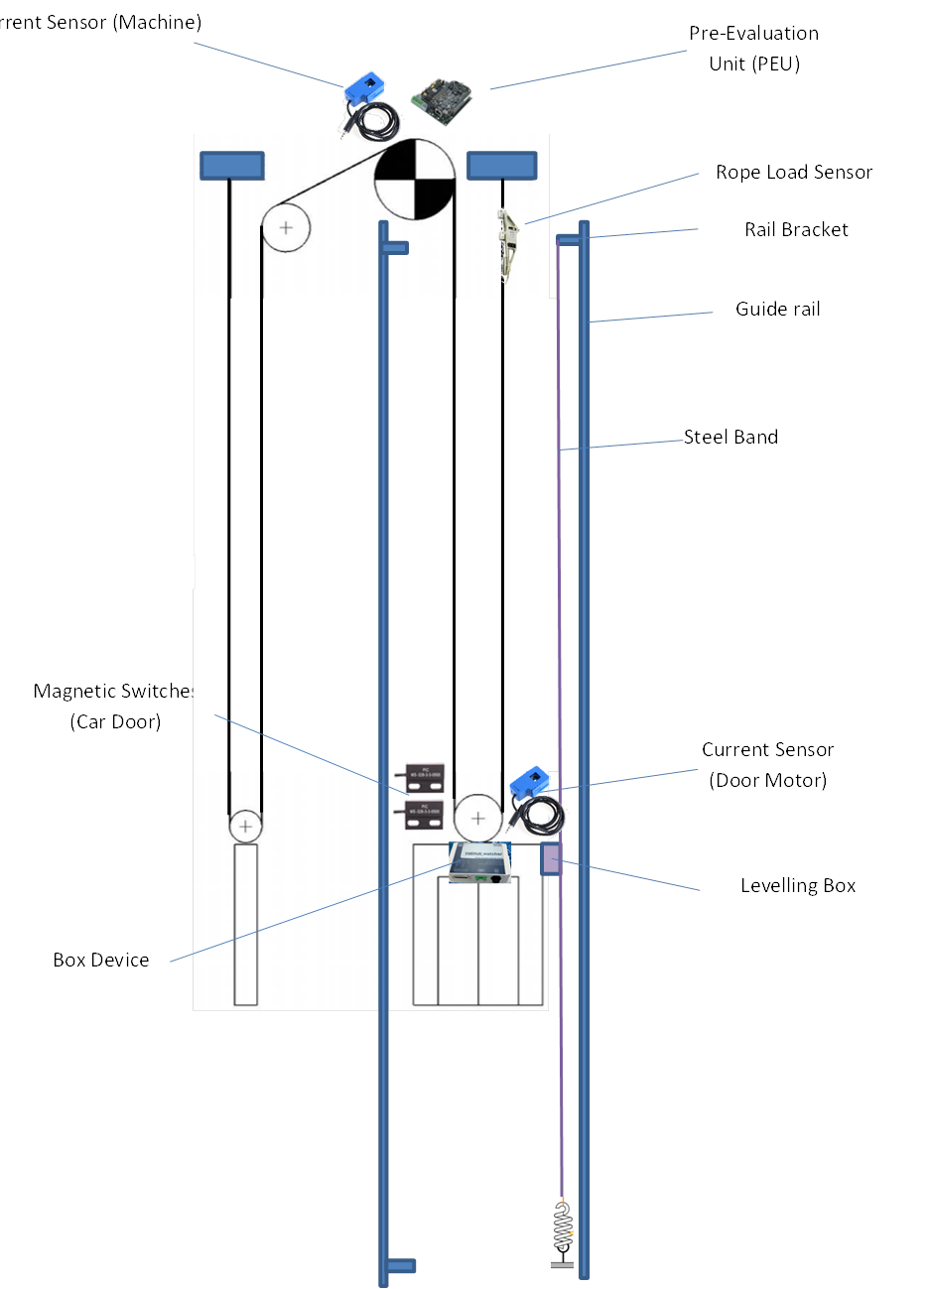
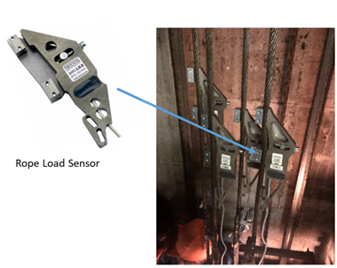
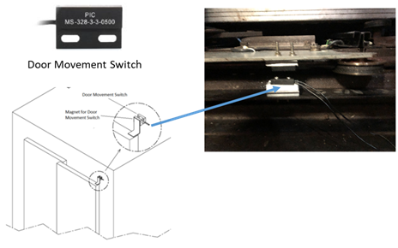
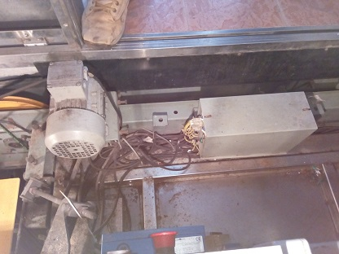
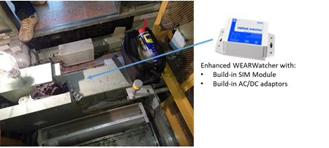
Lift Sensors Installation Plan
Absolute Positioning Sensor
+ Steel Band
Pre-Evaluation Unit
with Current Senor
and Rope Load Sensor
Magnetic Door Switches
Current Sensor
Main Processing Unit

Slide 7
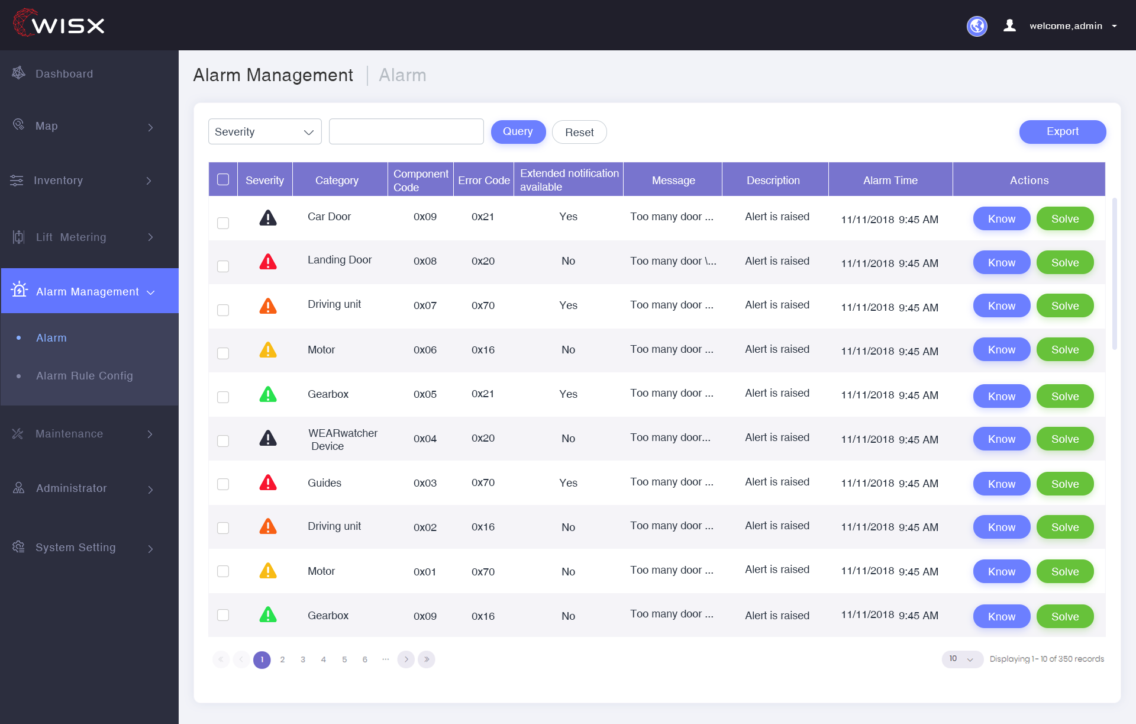
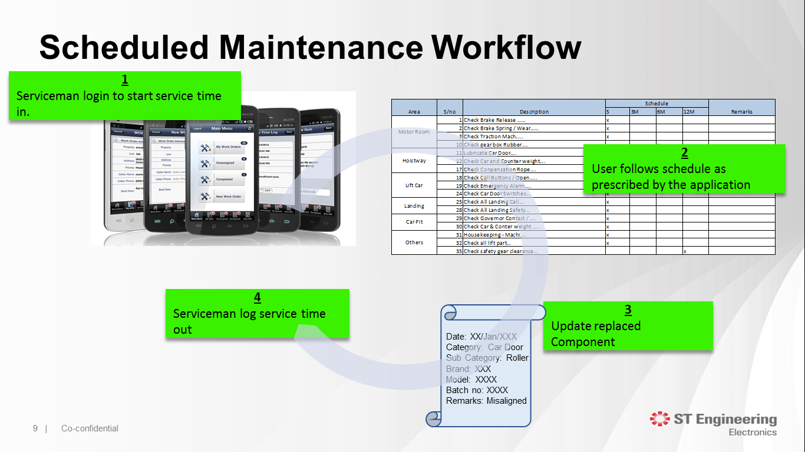
WISX Smart Lift CMS
Real-time status monitoring
Automatic events identification and real time alerts
Remote access to sensor performance
Lift and lift maintenance KPIs
Smart Map View
Digital Lift Service Inspection Report
Lift / Lift Component Replacement Tracking
Configurable Checklists for Maintenance Tasks
Data history, reporting and analytics

Slide 8
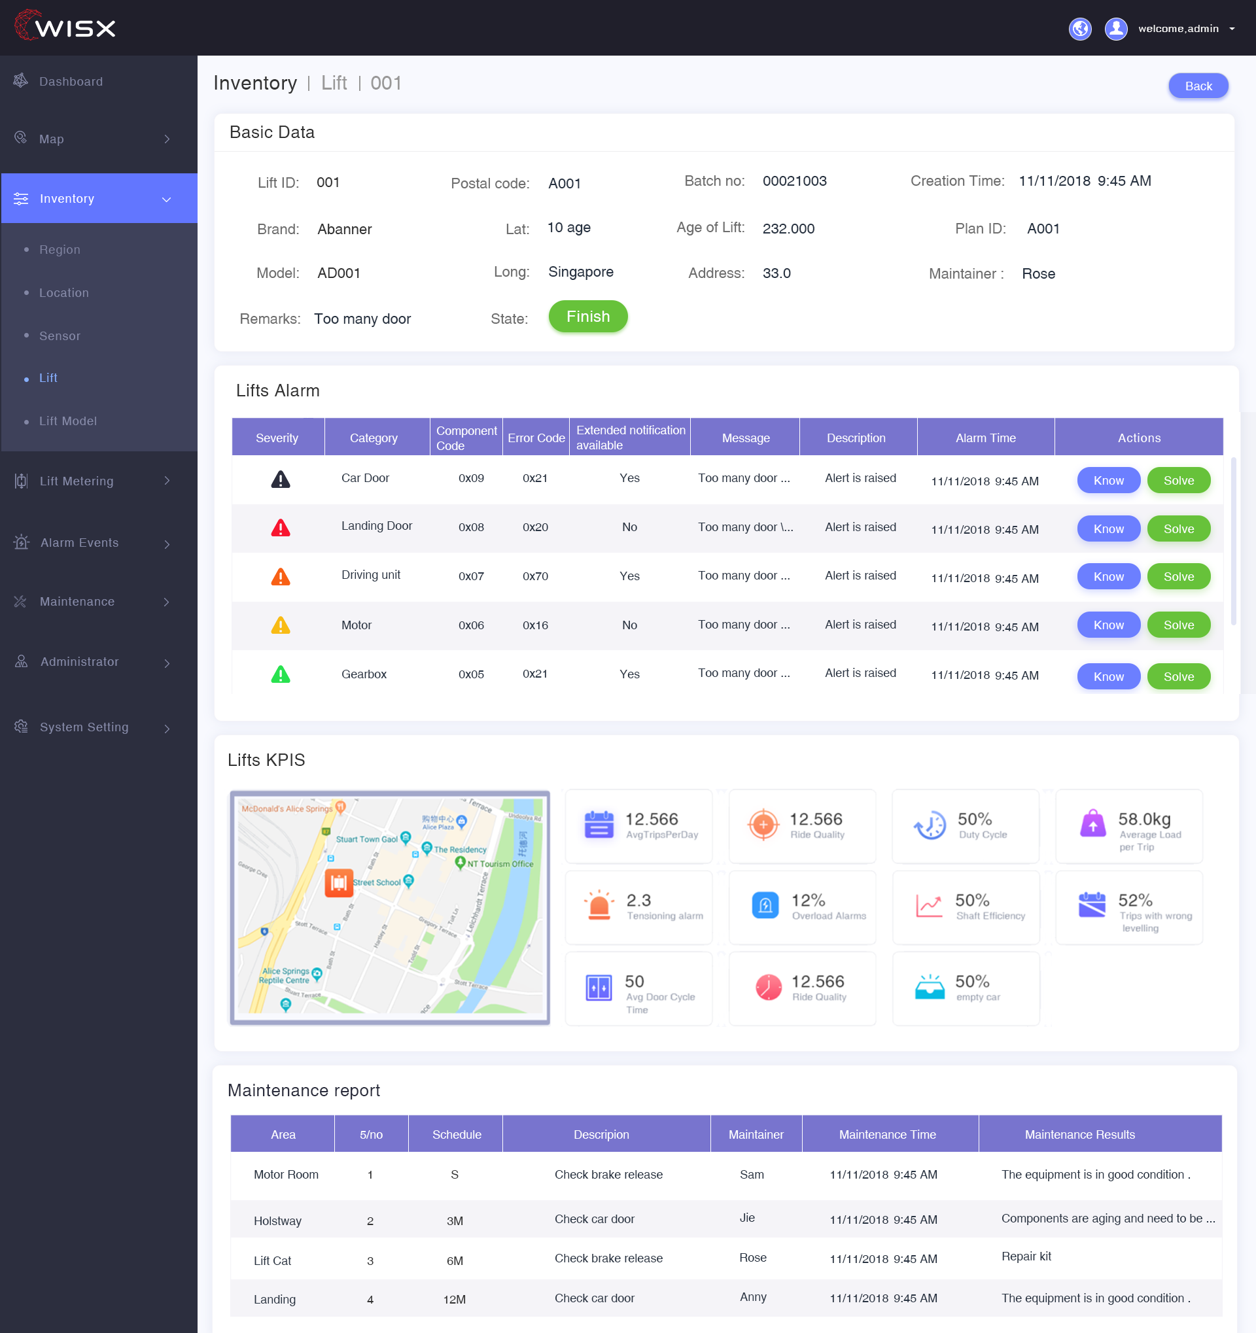
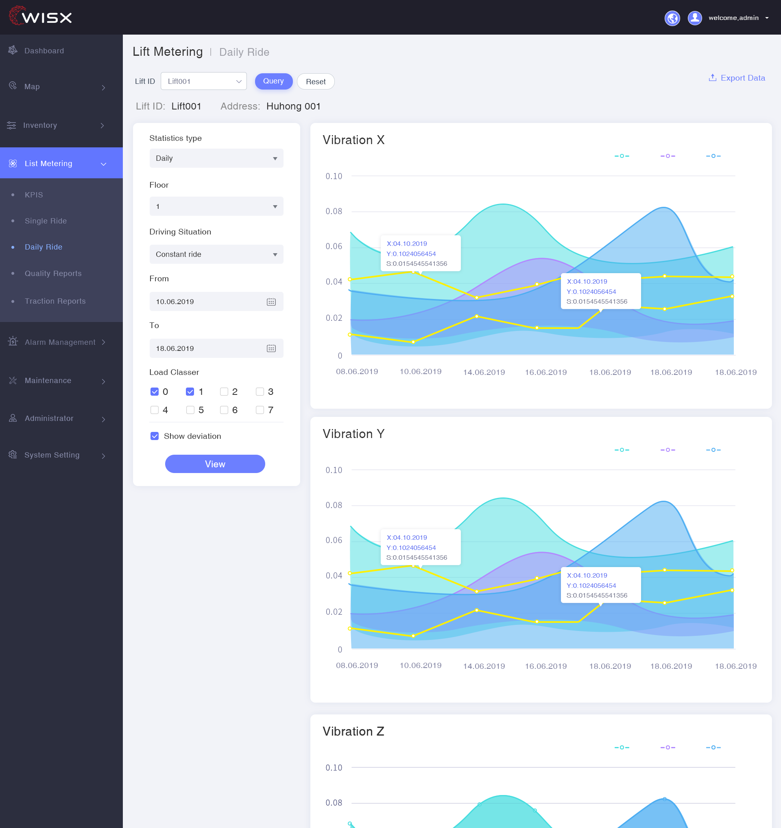
WISX Smart Lift CMS

Slide 9
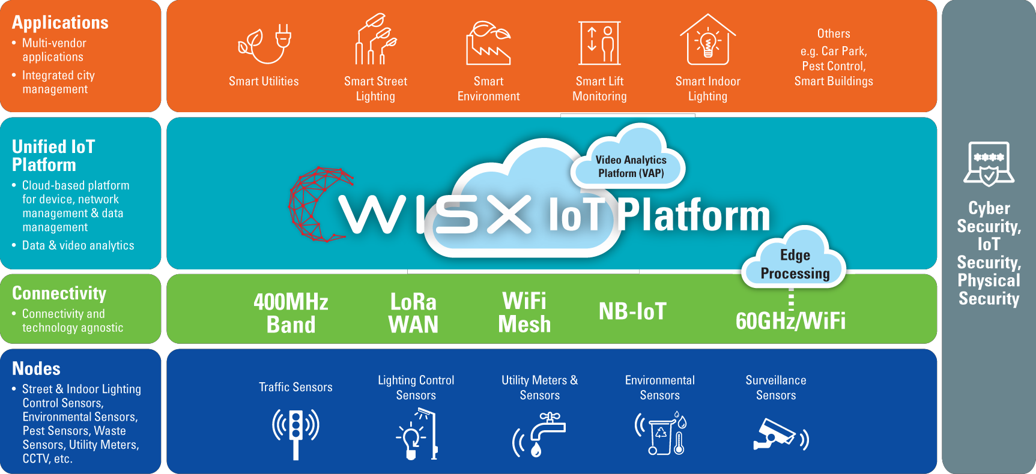
Powered by Wisx – Open IoT Platform

Slide 10
Thank You

